Slide 1
Requirement Engineering

Slide 2
Topics covered
Functional and non-functional requirements
Requirements engineering processes
Requirements elicitation
Requirements specification
Requirements validation
Requirements management

Slide 3
Requirements engineering
Establishing what the customer requires from a software system
The process of establishing the services that the customer requires from a system and the constraints under which it operates and is developed
The system requirements are the descriptions of the system services and constraints that are generated during the requirements engineering process.
What is a requirement?

Slide 4
Requirement Documents
Requirements specification (SRS)
A structured document setting out detailed descriptions of the system services. Written as a contract between client and contractor
Software specification
A detailed software description which can serve as a basis for a design or implementation. Written for developers
It is NOT a design document. As far as possible, it should set of WHAT the system should do rather than HOW it should do it

Slide 5
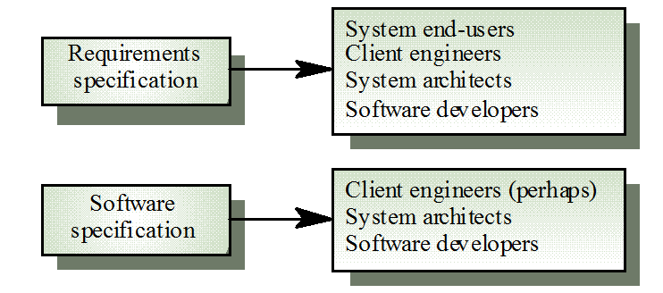

Slide 6
Requirements document contents
Specify external system behaviour
Specify implementation constraints
Easy to change
Serve as reference tool for maintenance
Record forethought about the life cycle of the system i.e. predict changes
Characterise responses to unexpected events

Slide 7
Requirements document structure
Introduction
Describe need for the system and how it fits with business objectives
Glossary
Define technical terms used
System models
Define models showing system components and relationships
Functional requirements definition
Describe the services to be provided

Slide 8
Requirements document structure
Non-functional requirements definition
Define constraints on the system and the development process
System evolution
Define fundamental assumptions on which the system is based and anticipated changes
Requirements specification
Detailed specification of functional requirements
Appendices
System hardware platform description
Database requirements (as an ER model perhaps)
Index

Slide 9
System stakeholders
Any person or organization who is affected by the system in some way and so who has a legitimate interest
Stakeholder types
End users
System managers
System owners
External stakeholders

Slide 10
Example: Stakeholders in the health care system
Patients whose information is recorded in the system.
Doctors who are responsible for assessing and treating patients.
Nurses who coordinate the consultations with doctors and administer some treatments.
Medical receptionists who manage patients’ appointments.
IT staff who are responsible for installing and maintaining the system.

Slide 11
Example: Stakeholders in the health care system
A medical ethics manager who must ensure that the system meets current ethical guidelines for patient care.
Health care managers who obtain management information from the system.
Medical records staff who are responsible for ensuring that system information can be maintained and preserved, and that record keeping procedures have been properly implemented.

Slide 12
Agile methods and requirements
Many agile methods argue that producing detailed system requirements is a waste of time as requirements change so quickly. The requirements document is therefore always out of date!
Agile methods usually use incremental requirements engineering and may express requirements as ‘user stories’.
This is practical for business systems but problematic for systems that require pre-delivery analysis or systems developed by several teams.

Slide 13
Functional and non-functional requirements

Slide 14
Functional and non-functional requirements
Functional requirements
Statements of services the system should provide, how the system should react to particular inputs and how the system should behave in particular situations.
May state what the system should not do.
Non-functional requirements
Constraints on the services or functions offered by the system such as timing constraints, constraints on the development process, standards, etc.
Often apply to the system as a whole rather than individual features or services.

Slide 15
Functional requirements
Describe functionality or system services.
Depend on the type of software, expected users and the type of system where the software is used.
Functional user requirements may be high-level statements of what the system should do.
Functional system requirements should describe the system services in detail.

Slide 16
Health care system: functional requirements
A user shall be able to search the appointments lists for all clinics.
The system shall generate each day, for each clinic, a list of patients who are expected to attend appointments that day.
Each staff member using the system shall be uniquely identified by his or her 8-digit employee number.

Slide 17
Non-functional requirements
These define system properties and constraints e.g. reliability, response time and storage requirements. Constraints are I/O device capability, system representations, etc.
Process requirements may also be specified mandating a particular IDE, programming language or development method.
Non-functional requirements may be more critical than functional requirements. If these are not met, the system may be useless.

Slide 18
Non-functional requirements implementation
Non-functional requirements may affect the overall architecture of a system rather than the individual components.
For example, to ensure that performance requirements are met, you may have to organize the system to minimize communications between components.
A single non-functional requirement, such as a security requirement, may generate a number of related functional requirements that define system services that are required.
It may also generate requirements that restrict existing requirements.

Slide 19
Non-functional classifications
Product requirements
Requirements which specify that the delivered product must behave in a particular way e.g. execution speed, reliability, etc.
Organisational requirements
Requirements which are a consequence of organisational policies and procedures e.g. process standards used, implementation requirements, etc.
External requirements
Requirements which arise from factors which are external to the system and its development process e.g. interoperability requirements, legislative requirements, etc.

Slide 20
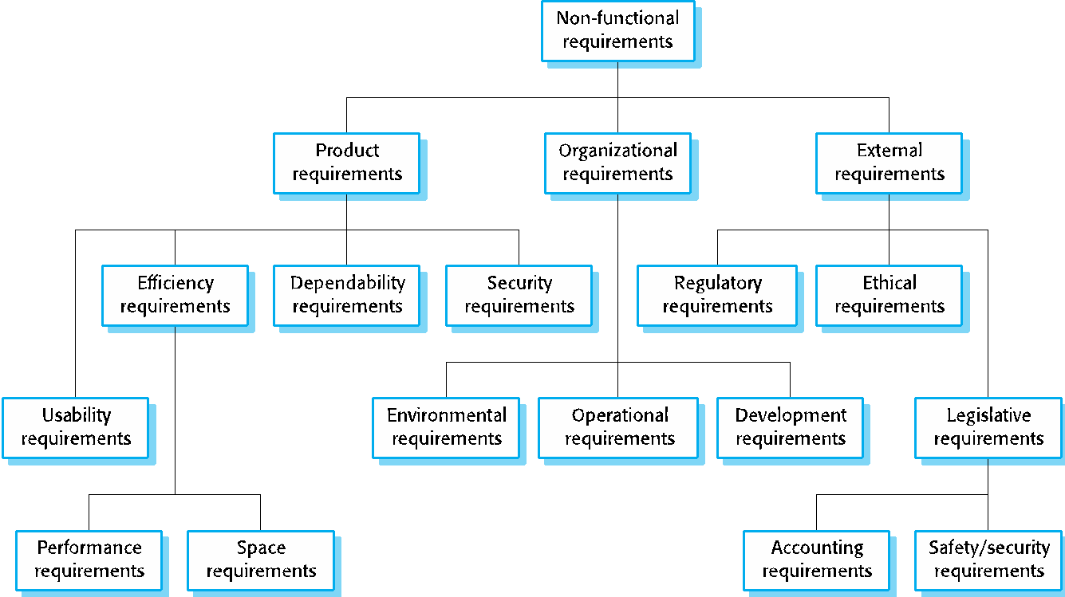
Types of nonfunctional requirement

Slide 21
Requirements engineering processes

Slide 22
Requirements engineering processes
Establishing what the customer requires from a software system
The processes used for RE vary widely depending on the application domain, the people involved and the organisation developing the requirements.
However, there are a number of generic activities common to all processes
Requirements elicitation;
Requirements specification;
Requirements validation;
Requirements management.

Slide 23
Problems of requirements engineering
Stakeholders don’t know what they really want.
Stakeholders express requirements in their own terms.
Different stakeholders may have conflicting requirements.
Organisational and political factors may influence the system requirements.
The requirements change during the analysis process. New stakeholders may emerge and the business environment may change.

Slide 24
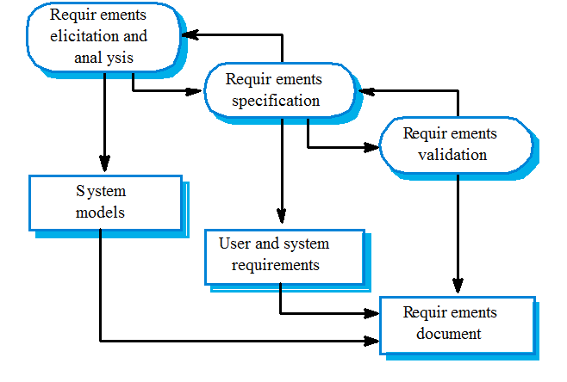
SRS: System requirements specification

Slide 25
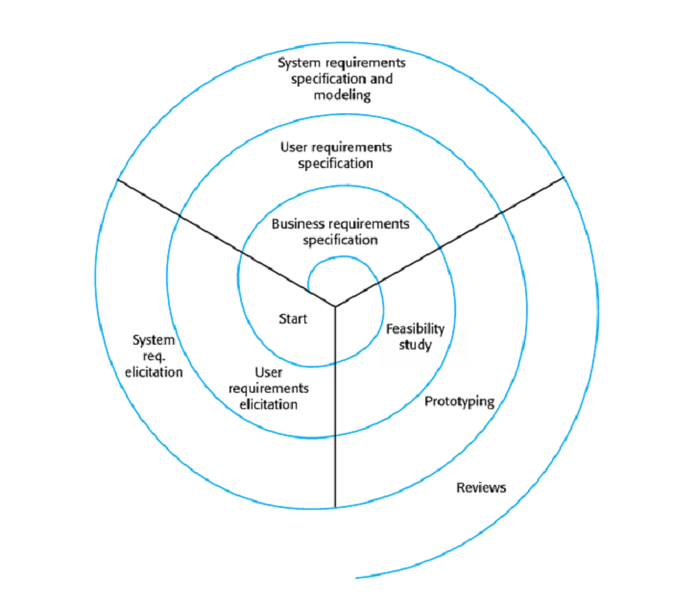
A spiral view of the requirements engineering process
Req Specification
Req Elicitation
Req Validation
System Requirement Documents / SRS

Slide 26
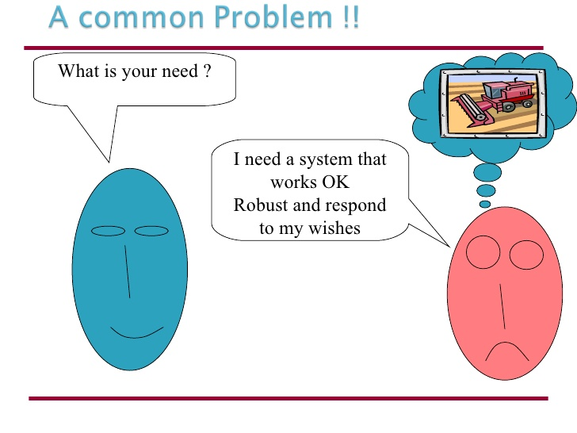
Requirements elicitation

Slide 27
Requirements elicitation
Sometimes called requirements elicitation or requirements discovery.
Involves technical staff working with customers to find out about the application domain, the services that the system should provide and the system’s operational constraints.
May involve end-users, managers, engineers involved in maintenance, domain experts, trade unions, etc. These are called stakeholders.

Slide 28
Steps to follow
Requirements discovery
Interacting with stakeholders to discover their requirements. Domain requirements are also discovered at this stage.
Requirements classification and organisation
Groups related requirements and organises them into coherent clusters.
Prioritisation and negotiation
Prioritising requirements and resolving requirements conflicts.
Requirements specification
Requirements are documented and input into the next round of the spiral.

Slide 29
Elicitation techniques
interview
brainstorming session
task analysis
questionnaire
scenario analysis
ethnography
form analysis
analysis of natural language descriptions
synthesis from existing system
domain analysis
Business Process Redesign (BPR)
prototyping

Slide 30
Scenario-Based Analysis (library system example)
first shot:
check due back date
if overdue, collect fine
record book as being available again
put book back
as a result of discussion with library employee:
what if person returning the book is not registered as a client?
what if the book is damaged?
how to handle in case the client has other books that are overdue, and/or an outstanding reservation?

Slide 31
Interviewing
Formal or informal interviews with stakeholders are part of most RE processes.
Types of interview
Structured closed interviews, where every single information to gather is decided in advance, they follow pattern and matter of discussion firmly.
Non-structured open interviews, where information to gather is not decided in advance, more flexible and less biased.
Oral/ written interviews

Slide 32
Interviewing
One-to-one interviews which are held between two persons across the table.
Group interviews which are held between groups of participants. They help to uncover any missing requirement as numerous people are involved.

Slide 33
Questionnaires
Involves putting questions relevant to the topic so that to collect information
Validity
- sample size, audience
Reliability
Questions
- open ended
- fill in the blank
- multiple choice
- rating scales

Slide 34
Scenarios
Scenarios are stories which explain how a system might be used. They should include
- a description of the system state before entering the scenario
- the normal flow of events in the scenario
- exceptions to the normal flow of events
- information about concurrent activities
- a description of the system state at the end of the scenario

Slide 35
Observation and social analysis(Ethnography)
People often find it hard to describe what they do because it is so natural to them. Sometimes, the best way to understand it is to observe them at work
Ethnography is a technique from the social sciences which has proved to be valuable in understanding actual work processes
Ethnography aims to describe the nature of those who are studied (i.e. to describe a people, an ethnos) through writing

Slide 36
Meetings
Meetings consume resources
must improve quality of meetings
Meetings have different objectives
solve problems, clarify issues
brainstorm solutions to problems
resolve conflicts
conduct reviews
collect and merge facts and data
report progress
assign actions

Slide 37
Prioritizing requirements (MoSCoW)
Must haves: top priority requirements
Should haves: highly desirable
Could haves: if time allows
Won’t haves: not today

Slide 38
Requirements specification

Slide 39
Requirements specification
The process of writing the user and system requirements in a requirements document.
User requirements have to be understandable by end-users and customers who do not have a technical background.
System requirements are more detailed requirements and may include more technical information.
The requirements may be part of a contract for the system development
It is therefore important that these are as complete as possible.

Slide 40
Guidelines for writing requirements
Invent a standard format and use it for all requirements.
Use language in a consistent way. Use shall for mandatory requirements, should for desirable requirements.
Use text highlighting to identify key parts of the requirement.
Avoid the use of computer jargon.
Include an explanation (rationale) of why a requirement is necessary.

Slide 41
Problems with natural language
Lack of clarity
Precision is difficult without making the document difficult to read.
Requirements confusion
Functional and non-functional requirements tend to be mixed-up.
Requirements amalgamation
Several different requirements may be expressed together.

Slide 42
Requirements validation

Slide 43
Requirements validation
Concerned with demonstrating that the requirements define the system that the customer really wants.
Requirements error costs are high so validation is very important
Fixing a requirements error after delivery may cost up to 100 times the cost of fixing an implementation error.

Slide 44
What to check?
Validity.
Does the system provide the functions which best support the customer’s needs?
Consistency.
Are there any requirements conflicts?
Completeness.
Are all functions required by the customer included?
Realism.
Can the requirements be implemented given available budget and technology
Verifiability.
Can the requirements be checked?

Slide 45
Requirements validation techniques
Requirements reviews
Systematic manual analysis of the requirements.
Prototyping
Using an executable model of the system to check requirements. Covered in Chapter 2.
Test-case generation
Developing tests for requirements to check testability.

Slide 46
Requirements reviews
Regular reviews should be held while the requirements definition is being formulated.
Both client and contractor staff should be involved in reviews.
Reviews may be formal (with completed documents) or informal. Good communications between developers, customers and users can resolve problems at an early stage.

Slide 47
Review checks
Verifiability
Is the requirement realistically testable?
Comprehensibility
Is the requirement properly understood?
Traceability
Is the origin of the requirement clearly stated?
Adaptability
Can the requirement be changed without a large impact on other requirements?

Slide 48
The End!

